Slide 1

Interrupts & System Calls implementation in Linux

Slide 2
Outline
Interrupt
Linux OS & System Calls
NASM Programming
  Program structure
  Declaring variables
  I/O operations
  Sample Programs

Slide 3

Question??
When you are at home sitting on your lazy boy, how do you know when someone wants to talk to you on the phone?
  Do you periodically get up and pick up the phone to see if someone is there?
  Or do you wait till the phone rings to answer it?

Slide 4
Answer?
The first scenario shows a person doing what is known as polling.
The second case illustrates an interrupt-driven person.

Slide 5
Interrupt
Device sends a special signal to CPU when data arrives.
“Wake me up when we get there.”
Responds to hardware interrupt signal by interrupting current processing.
Now CPU can perform tasks before and after interrupt instead of just polling!! Good!

Slide 6
Interrupt is an asynchronous event which can take the execution control of the CPU
Steps in interrupt execution
Completes current instruction
Saves current state to status registers
Identify the source
Jump to and activate Interrupt Service Routing (ISR)
Return to original program and restore state

Slide 7
IVT
An "interrupt vector table" (IVT) is a data structure that associates a list of interrupt handlers with a list of interrupt requests in a table of interrupt vectors.
An entry in the interrupt vector is the address of the interrupt handler.
The first 1Kbyte of memory of 8086 (00000 to003FF) is set aside as a table for storing the starting addresses of Interrupt Service Procedures (ISP).
The starting address of an ISP is often called the Interrupt Vector or Interrupt Pointer. Therefore the table is referred as Interrupt Vector Table

Slide 8
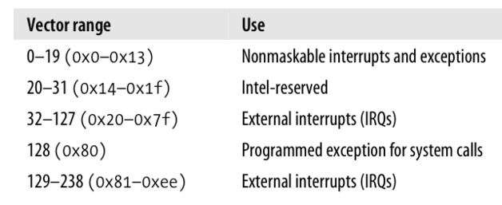
Vector Range

Slide 9
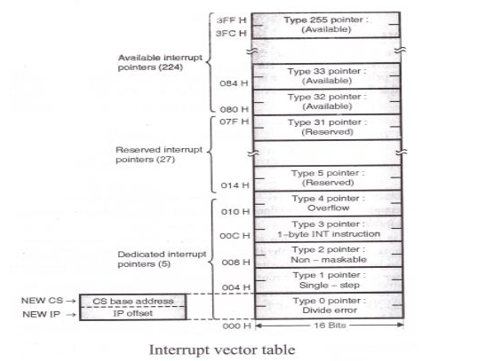

Slide 10
Structure of Linux OS

Slide 11
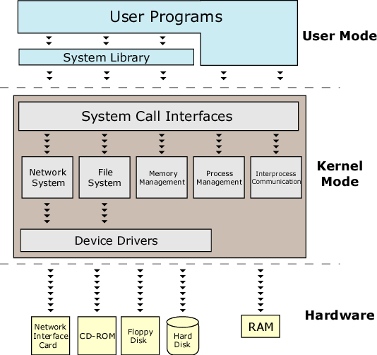

Slide 12
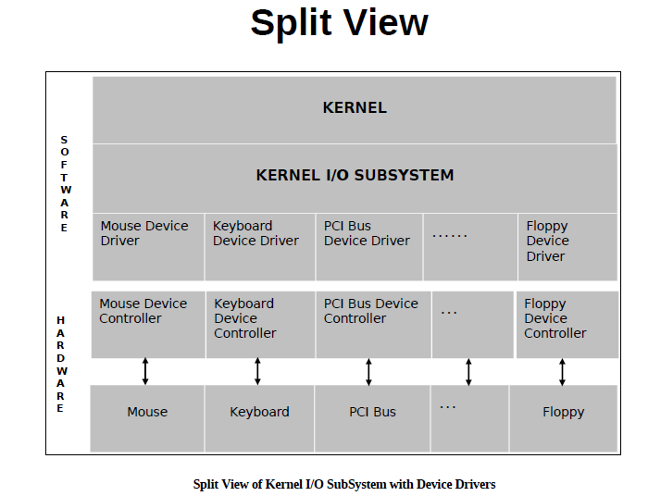

Slide 13
Linux Architecture
Applications
System Libraries (libc)
System Call Interface
I/O Related
Process Related
Modules
File Systems
Scheduler
Networking
Memory Management
Device Drivers
IPC
Architecture-Dependent Code
Hardware
Notes:
Stephen Tweedie claims “All kernel code executes in a process context (except during startup)”. He also says that it is possible for an interrupt to occur during a context switch.
So it is uncommon for there to be no user process mapped. The real problem is not knowing what process is mapped. Kernel mode, system context activities occurs asynchronously and may be entirely unrelated to the current process.

Slide 14
System Calls
Interface between user-level processes and hardware devices like CPU, memory, disks etc.
Make programming easier:
  Let kernel take care of hardware-specific issues.
Increase system security:
  Let kernel check requested service via system call.
Provide portability:
  Maintain interface but change functional implementation.

Slide 15
System calls
System calls (or syscalls) are function calls made from user space programs into the kernel requesting for some service
Examples:
Open( ),read( ), write( ), fork( ), lseek( ), clone( ), wait ( ), etc..

Slide 16
Application using Standard Library Interface
#include <stdio.h>
int main()
{
printf(“Hello World\n”);
return(0);
}

Slide 17
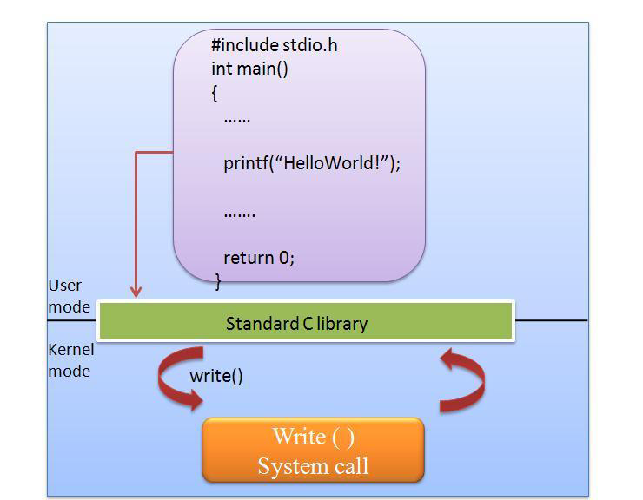
Standard library Vs system call

Slide 18
Application using System Call Interface
include <unistd.h>
int main()
{
write(1,”Hello World\n”, 12);
return(0);
}

Slide 19
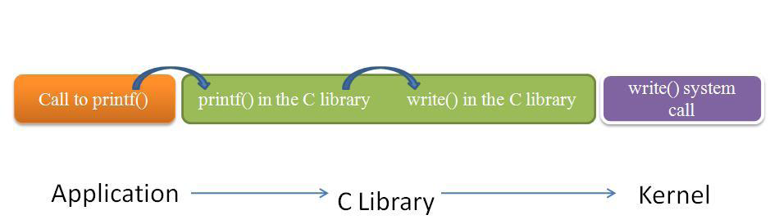
Application ->C Library ->KernelCentre

Slide 20
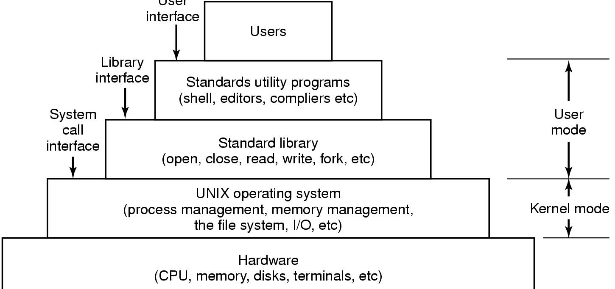
The layers of a LINUX system
User
Interface

Slide 21
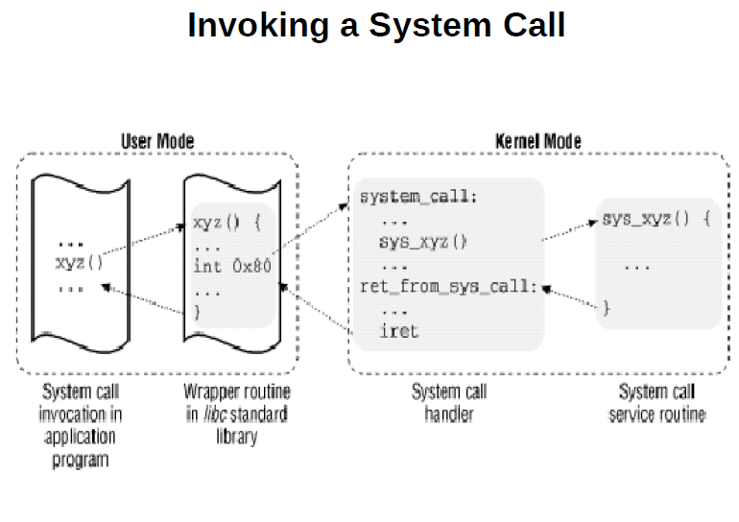

Slide 22
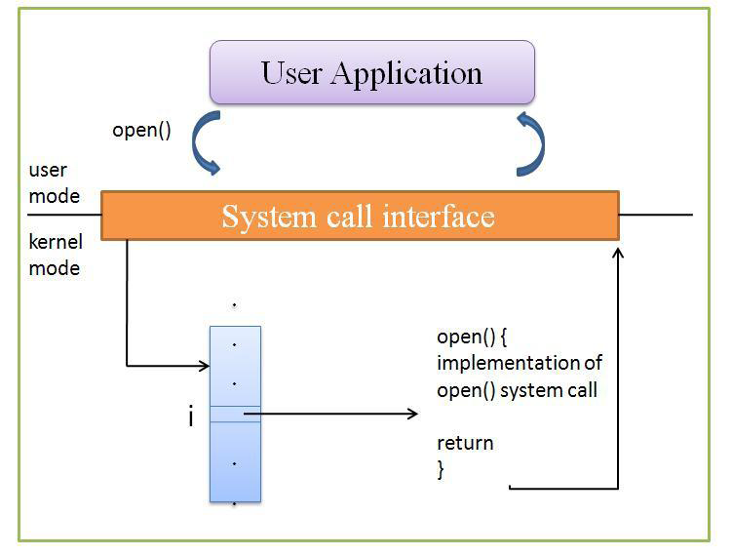
Access to kernel services

Slide 23
System Call Handling
User-space applications cannot execute kernel code directly
The mechanism to signal the kernel is a software interrupt
Occurs through an exception and then the system will switch to kernel mode and execute the exception handler

Slide 24
System call Handling
Each system call is assigned a syscall number.
The kernel keeps a list of all registered system calls in the system call table, stored in sys_call_table.
On x86, the syscall number is fed to the kernel via the eax register.

Slide 25
Linux System Calls
Invoked by executing int $0x80.
  Programmed exception vector number 128.
  CPU switches to kernel mode & executes a kernel function.
Calling process passes syscall number identifying system call in eax register (on Intel processors).
Syscall handler responsible for:
  Saving registers on kernel mode stack.
  Invoking syscall service routine.

Slide 26
Parameter Passing
On the 32-bit Intel 80x86:
  6 registers are used to store syscall parameters.
    eax (syscall number).
    ebx, ecx, edx, esi, edi store parameters to syscall service routine, identified by syscall number.

Slide 27
Parameter passing
In case of six or more arguments, a single register is used to hold a pointer to user-space where all the parameters are stored
The return value is sent to user-space also via register. On x86, it is written into the eax register

Slide 28
NASM Programming
Chapter 3,4 & 5 NASM manual

Slide 29
Why Assembly Language ?
you will get a better idea of computer organization and how a program executes in a computer.
A program written in assembly language will be more efficient than the same program written in a high level language.
Some portions of Operating System (Eg: Linux kernel) and some system software are written in assembly language.

Slide 30
X86 architecture
The x86 architecture is an Instruction Set Architecture (ISA) series for computer processors.
Developed by Intel Corporation, x86 architecture defines how a processor handles and executes different instructions passed from the operating system (OS) and software programs.
The ’x’ in x86 denotes ISA version.

Slide 31
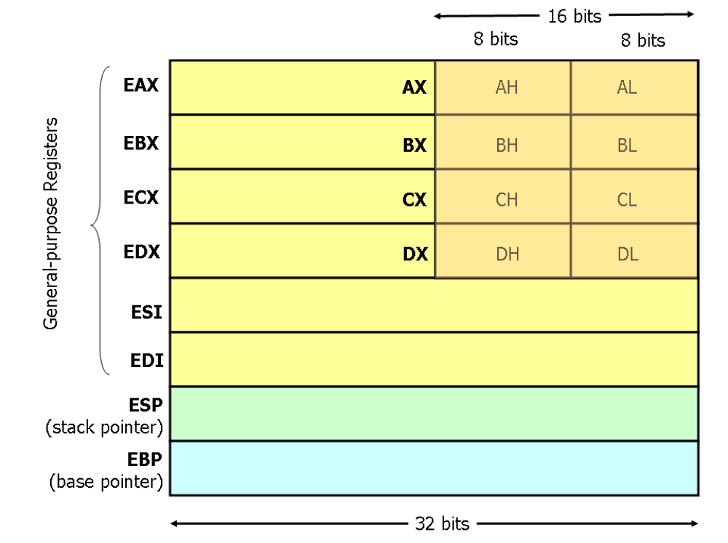
X86(i386) Registers

Slide 32
NASM
The Netwide Assembler is an assembler and disassembler for the Intel X86 architecture
NASM is considered to be one of the most popular assemblers for Linux.

Slide 33
NASM Installation
NASM is freely available on internet.
In Ubuntu Linux you can give the command :
  sudo apt-get install nasm
and in fedora you can use the command:
  su -c yum install nasm
in a terminal and easily install nasm

Slide 34
Sections in NASM
1. section .text :
This section contains the executable code from where execution starts. It is analogous to the main() function in C.
2. section .bss :
Here, variables are declared without initialization.
3. section .data :
Variables are declared and initialized in this section

Slide 35
declaring space in the memory
(a) RESx:
Reserve just space in memory for a variable without giving any initial values.
(b) Dx:
Declaring space in the memory for any variable and also providing the initial values at that moment. Where x can be replaced with different characters as shown in the below table.

Slide 36
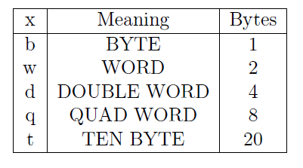

Slide 37
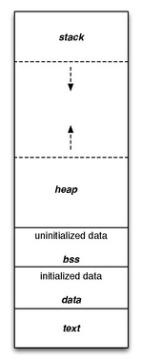
RAM memory layout

Slide 38
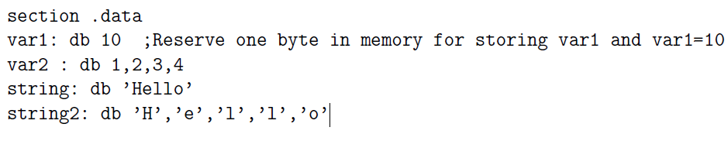
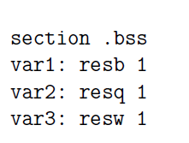
bss stands for block starting symbol

Slide 39
Compilation
Assembling the source file
  nasm -f elf filename.asm
  This creates an object file, filename.o in the current working directory.
Creating an executable file
  ld filename.o -o output_filename ( 32 bit machine)
  ld -melf_i386 filename.o -o output_filename (64bit)
This creates an executable file of the name output_filename.
Program execution
  ./output_filename

Slide 40
Sample execution
For example, if the program to be run is first.asm
  nasm -f elf first.asm
  ld first.o -o output
  ./output

Slide 41
Basic I/O in NASM
NASM does not support I/O operations directly
I/O in NASM Program is implemented using the Operating System’s read and write system call.
Interrupt no: 80h is as the software generated interrupt in Linux Systems.
Applications implement the System Calls using this interrupt.
When an application triggers int 80h, then OS will understand that it is a request for a system call and it will refer the general purpose registers to find out and execute the exact Interrupt Service Routine

Slide 42
1. Exit System Call
mov eax, 1 ; System Call Number
mov ebx, 0 ; Parameter
int 80h ; Triggering OS Interrupt

Slide 43
Read System Call
mov eax, 3 ; Sys_call number for read
mov ebx, 0 ; Source Keyboard
mov ecx, var ; Pointer to memory location
mov edx, dword[size] ; Size of the string
int 80h ; Triggering OS Interrupt
This method is also used for reading integers and it is bit tricky. If we need to read a single digit, we will read it as a single character and then subtract 30h from it(ASCII of 0 = 30h). Then we will get the actual value of that number in that variable.

Slide 44
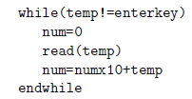
Reading single Digit
mov eax, 3
mov ebx, 0
mov ecx, digit1
mov edx, 1
int 80h
sub byte[digit1], 30h ;Now we have the actual number in [digit1]
Reading Multi digit number

Slide 45
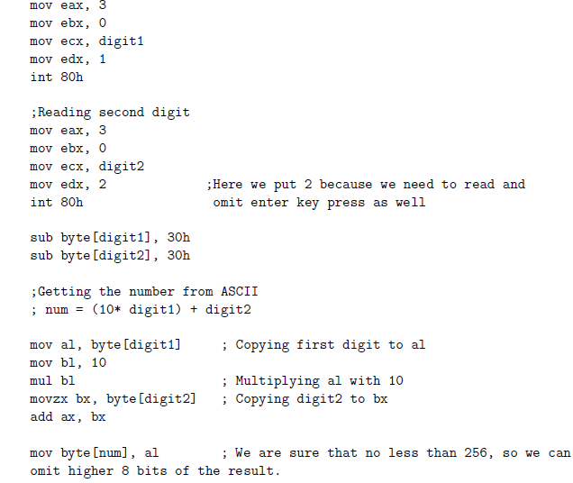
Reading a two digit number

Slide 46
Write System Call
mov eax, 4 ;Sys_call number
mov ebx, 1 ;Standard Output device
mov ecx, msg1 ;Pointer to output string
mov edx, size1 ;Number of characters
int 80h ;Triggering interrupt.
This method is even used to output numbers. If we have a number we will break that into digits. Then we keep each of that digit in a variable of size 1 byte. Then we add 30h (ASCII of 0) to each, doing so we will get the ASCII of character to be print.

Slide 47
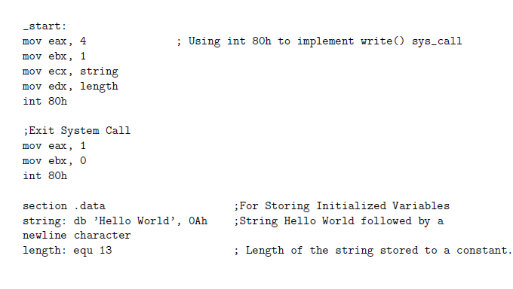
Hello world program
nasm -f elf first.asm
ld first.o -o output
./output

Slide 48
The text section is used for keeping the actual code. This section must begin with the declaration global _start, which tells the kernel where the program execution begins.
The syntax for declaring text section is −
Section .text
global _start
_start:

Slide 49
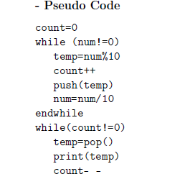
Printing a multi digit number

Slide 50
